Slide 1

Ayurveda Medical association of India aims & objectives a historical evaluation
Dr.V.G.Udayakumar
President, AMA Research Foundation

Slide 2

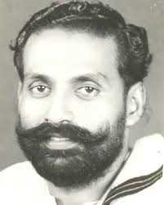
എ.എം.എ.ഐയുടെ ഉത്ഭവം
AYURVEDA MEDICAL ASSOCIATION
B.Welligton
ഐക്യകേരള രൂപീകരണത്തെ തുടർന്ന്ഏകീകൃത മെഡിക്കൽ ബിൽ കരടിൽ ബി ക്ലാസ് രജിസ്‌ട്രേഷൻ കേരളം മുഴുവൻ കൊടുക്കാൻ ശ്രമം - 196 7
വിദ്യാർഥികൾ സമരം ആരംഭിച്ചു
ആയുർവേദ മണ്ഡലത്തിന്റെ പിന്തുണ

Slide 3
എ.എം.എ.ഐയുടെ ഉത്ഭവം
യുവാക്കൾ മണ്ഡലം യോഗം ബഹിഷ്കരിച്ചു
  ഡോ.പി.കെ.ജയപ്രകാശ്,ഡോ.പി.കെ.രാമചന്ദ്രൻ, ഡോ.വി.എൻ.രാമകൃഷ്ണൻ, ഡോ.കെ.വി. ഷൺമുഖദാസ്
വടക്ക്: AMA ( Ayurveda Medical Association) 1968 - ൽ പാലക്കാട്

Slide 4
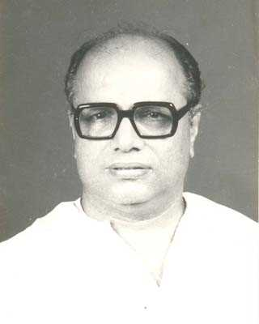
എ.എം.എ.ഐയുടെ ഉത്ഭവം
National Ayurveda Medical Association
N.K.Balakrishnan
ഹോമിയോപ്പതി MBS ഡിഗ്രിക്കെതിരെ ഐ.എം.എ നടത്തിയ സമരം 1976
അലോപ്പതി രംഗത്ത്ഐ.എം.എ സമാനമായി ആയുർവേദ മേഖലയിൽ ഒരു സംഘടന വേണമെന്ന യുവാക്കളുടെ ചിന്ത
South : An Ad hoc Committee was formed

Slide 5
AMAI Origins
In 1978 leaders of both organizations sit together at Guruvayoor (14.2.78) with initiation of Dr.T.Gopinath, Dr.Ramankutty and decided to merge.
The unification conference was held at Thrissur on 13.08.1978
  Dr.N.S.Narayanan Naiar (Tvpm)- President Dr.M.Gopalakrishnan(Kkd) - General secretary. Dr. K.V.Shanmukhadas (Tssr) Treaesurer

Slide 6
State Conference/ Office bearers
 | Year/Place | President | General Secretary | Treasurer
1 | 1979, KKD | N.S.Narayanan Nair | C.K. Divakaran | M.Gopalakrishnan
2 | 1980 TVPM | P.R.Sukumaran Nair | C.Rethnakaran | N.S.Narayanan Nair
3 | 1882 | N.S.Narayanan Nair | T.Gopinathan | M.Gopalakrishnan
4 | 1984 TSSR | P.Kumaran | G.Vinodkumar | N.S.Narayanan Nair
5 | 1985 EKM | G.Vinodkumar | V.V.Narayanan | T.V.Ramankutty Varrier
6 | 1988 KLM | J.Seetharaman | M.K.Baby | G.Vinodkumar
7 | 1990 PKD | J.Seetharaman | M.K.Baby | Balachandra Menon
8 | 1994 KKD | K.Anilkumar | V.G.Udayakumar | G.Vinodkumar

Slide 7
State Conference/ Office bearers
 | Year | President | General Secretary | Treasurer
9 | 1997 KTM | K.Anilkumar | S.Dilipkumar | T.A.Salim
10 | 2000 KLM | K.Anilkumar | S.Dilipkumar | T.A.Salim
11 | 2003 ALY | Rammohan | Mohan Cyriac | Balakrishnan
12 | 2007 ALY | V.G.Udayakumar | Joji Thachil | Baskaran
13 | 2010 TSSR | T.A.Salim | V.G.Udayakumar | Rajith Anand
14 | 2012 KKD | G.Vinodkumar | Rajith Anand | Ramachandran
15 | 2015 KLM | G.Vinodkumar | Rajith Anand | Mansoor Ali Gurikkal
16 | 2018 ALP | Raju Thomas | Sadath Dinakar | Mansoor Ali Gurikkal
17 | 2021EKM | Raju Thomas | Sadath Dinakar | Mansoor Ali Gurikkal

Slide 8

AMAI Aims & Objectives

Slide 9
AMAI Registration
Registered under ICSR act in 1996 at Malappuram.
Revised in 2010, Kasargode
Section 4
  Aims & Objectives

Slide 10

Aims & Objectives
1. Work for the development of Ayurveda by adopting all knowledge available in health sector.
2. Uplift Ayurveda as our National System of Medicine
3. Promote research and utilize the result for public interest.
Notes:
See bye law

Slide 11
Aims & Objectives
4. Prevent quackery
5. Improve Health Care Delivery System
6. Preservation of Medicinal plants
7. Contemporary development in Ayurveda education
8.Organize doctors for public health initiatives

Slide 12
Aims & Objectives
9. Propagation of scientific literature
10.Healthy co operation with different medical systems
11. Organize heath awareness programmes
12. Work for doctors welfare
Notes:
See bye law

Slide 13
Role of AMAI in Ayurveda sector
തിരുത്തൽ ശക്തി
സമരങ്ങൾ ക്ക് പിന്തുണ നൽകിയും മുന്നണി പോരാളിയായും
വ്യാജചികിത്സക്കെതിരെ
സ്വകാര്യ ചികിത്സാ രംഗത്തെ പ്രശ്നങ്ങൾ പരിഹരിക്കുന്നതിന്

Slide 14
Role of AMAI in Ayurveda sector
ശാസ്ത്ര വികസനവും പശ്ചാത്തല വികസനവും
നയരൂപീകരണം
തൊഴിൽ ലഭ്യതക്കും സുരക്ഷക്കും വേണ്ട പ്രവർത്തനങ്ങൾ

Slide 15
Role of AMAI in Ayurveda sector
പ്രസിദ്ധീകരണം
ആയുർവേദ പ്രചാരണം
അംഗങ്ങളുടെ ക്ഷേമ പ്രവർത്തനങ്ങൾ
നിയമ സംരക്ഷണം

Slide 16
Anti Quackery movements
Protest against quackery in the name of Tribal medicine.1989 ( Dr.J.Seetha Raman& Dr.M.K.Baby)
Movements against Ayurveda Ratnam course, Kodungallur. 1990-91 ( Dr.J.Seetha Raman& Dr.M.K.Baby)
Ikyavedi talks to settle issue of B Class Registration.

Slide 17
Anti Quackery movements
Historical win over quacks by Hon: High Court of Kerala verdict in 2003 – Unqualified persons not to practice medicine. ( Dr.K.Anilkumar & Dr.S.Dilipkumar)
  Govt: openly defense quacks , Commission declared for TM
Anti quackery campaign in 2005-2007.( Dr.Mohan cyriac& Dr.Rammohan)
  Citadel Kozhikkode closed .

Slide 18
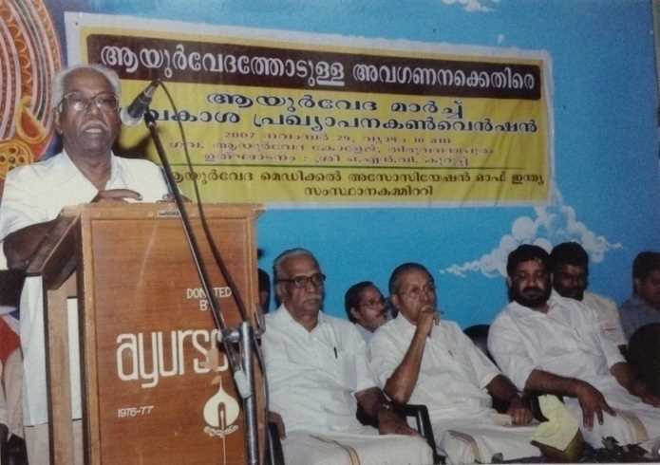
Anti Quackery movements
Convention for right declaration & March against quackery Tvm 2008. (Dr.V.G.Udayakumar & Dr.Joji Thachil)
Strike to withdraw GO for granting recognition to quacks in 2009. (Dr.V.G.Udayakumar & Dr.Joji Thachil)
B Class Commission report submitted report according to AMAI view.

Slide 19
Anti Quackery movements
Review petition on Homeo case in Supreme court
Impeding petition in Supreme Court against Paramparya Vaidya Federation appeal.
Movement against B Class Registration in Naturopathy in 2010.

Slide 20
Anti Quackery movements
Exemption to quacks through Section 38 2011
GO stayed in 2011with 2nd petition (Dr.V.G. Udayakumar & Dr.T.A.Salim)
Council interventions- TCMC, CCIM
Tvpm dist. Panchayat project 2015 (Dr.G.Vinod kumar& Dr.Rejith Anand)
Kozhikkode Prophet medicine course prevented - 2017

Slide 21
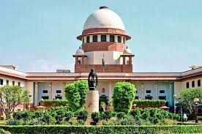
Anti Quackery movements
Historical judgment from Apex court
Medical Practice is not fundamental right : Supreme Court 2018 April 13 (2009 – 2018)
  Should be under relevant laws
  Quacks are playing with lives.
  Paramparya organizations are fake organizations
  Govt should be vigilant in checking quackery.

Slide 22
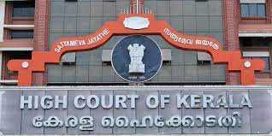
Kerala High Court verdict on (14.10.20)
The State Government Orders issued exempting registration for unqualified Ayurveda practitioners are quashed;
The State Government Orders for registration of unqualified practitioners of Naturopaths and other alternative medicines also will stand quashed; and

Slide 23
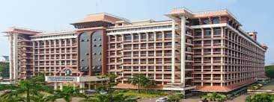
Kerala HC Dismissed Section 38(14.10.20)
The section 38 of the TC MP Act1953 is declared Unconstitutional and therefore struck down'

Slide 24
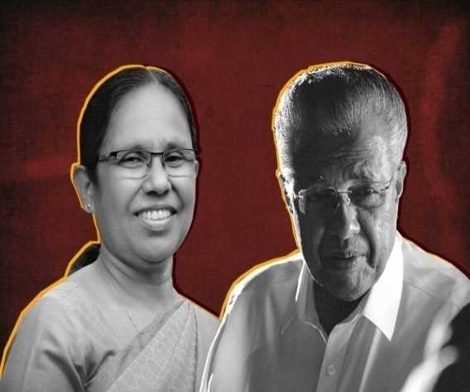
The ultimate goal- KMP Bill
Kerala State Medical Practitioners Bill 2021
  No provision for recognition to unqualified practitioners
  Penalty increased
  Penalty for fake degrees
  Penalty for fake courses

Slide 25
സ്വകാര്യ ചികിത്സാ രംഗത്തെ ഇടപെടലുകൾ
വ്യാജ ചികിത്സാക്കെതിരെ 1978 - 2022
Struggle for the right to use diagnostic equipments 1983
എക്‌സൈസ് അതിക്രമങ്ങൾക്കെതിരെ 1984.
Ayurveda Centre Bill 2007 stopped (Dr.V.G.Udayakumar & Dr.Joji Thachil)

Slide 26
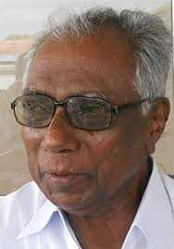
സ്വകാര്യ ചികിത്സാ രംഗത്തെ ഇടപെടലുകൾ
Excise license issue cleared 2008 -14 - 20 (Dr. Salim TA & Dr Udayakumar)

Slide 27
സ്വകാര്യ ചികിത്സാ രംഗത്തെ ഇടപെടലുകൾ
Food license issue 2015 (Dr.G.Vinod Kumar &Dr.Rejith Anand)
Pollution control issue 2016-21 ,,
Eye certification recognition 2016 ,,
PG Diploma courses. (Dr.Raju Thomas & Dr.Sadath Dinakar)
Fitness certification 2021 ,,

Slide 28
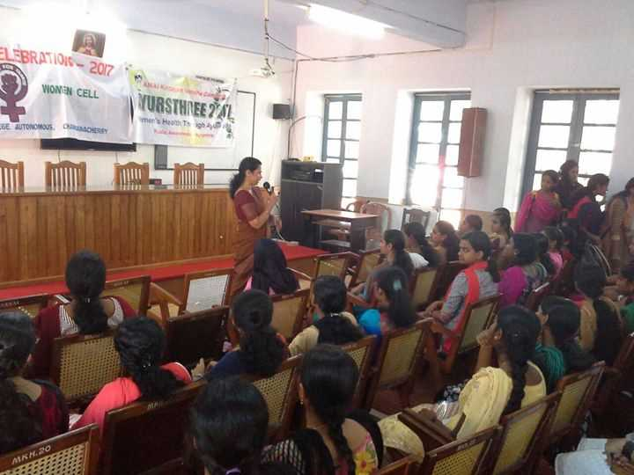
സ്വകാര്യ ചികിത്സാ രംഗത്തെ ഇടപെടലുകൾ
Panchakarma workshop in 1995 (Dr.K.Anilkumar& Dr.V.G.Udayakumar)
Peoples campaign in 9th Plan / 100 Dispensaries
Women’s Clinic 2013 (Dr.G.Vinod Kumar &Dr.Rejith Anand)
AMAI Vaidyasala
Life style clinics in training.

Slide 29
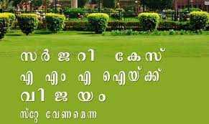
സ്വകാര്യ ചികിത്സാ രംഗത്തെ ഇടപെടലുകൾ
Bridge course on emergency medicine
Caveat on surgery case on Apex court
Impeding petition on IMA’s case

Slide 30
ഔഷധ രംഗത്തെ ഇടപെടലുകൾ
Separate Drug Control department 2008 (Dr.V.G.Udayakumar & Dr.Joji Thachil)
For implementing DMR Act 2008 onwards / Govt initiated actions
Case against Musli power extra
Case against Kizhi adds.
Avoiding such sponsorship in programmes.

Slide 31
System Development
Separate Drug Control department 2008 (Dr.V.G.Udayakumar & Dr.Joji Thachil)
Ayush Department 2015 (Dr.G.Vinod Kumar &Dr.Rejith Anand)

Slide 32
Tourism sector intervention
Ayurveda Centre Bill 2007 stopped
Sub committee in Tourism sector
Covid related protection schemes (Dr.Raju Thomas & Dr.Sadath Dinakar)
Proposal for Tourism regulatory authority

Slide 33
For employment generation
Panchakarma workshop in 1995 (Dr.K.Anilkumar& Dr.V.G.Udayakumar)
Peoples campaign in 9th Plan / 100 Dispensaries (Dr.K.Anilkumar& Dr.Dilipkumar)
Women’s Clinic 2013 (Dr.G.Vinod Kumar &Dr.Rejith Anand)
MO posts in colleges ,,
Yoga projects Proposals ,,

Slide 34
For employment generation
Various skill development programmes.
Proposal for RMO’s
Proposal for Additional MO in GAD’s
Specialty posts in district, Taluk hospitals
AMA Academy 2021

Slide 35
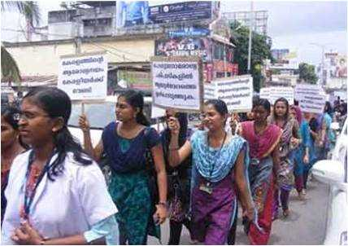
AMAI interventions
Education sector
Struggle for BAMS course 1978
Supported Kottakkal AVC students strike for want of facilities 1985.
Supported Ollur AVC students strike for college hospital 1986.
Struggle against private college 1986.

Slide 36
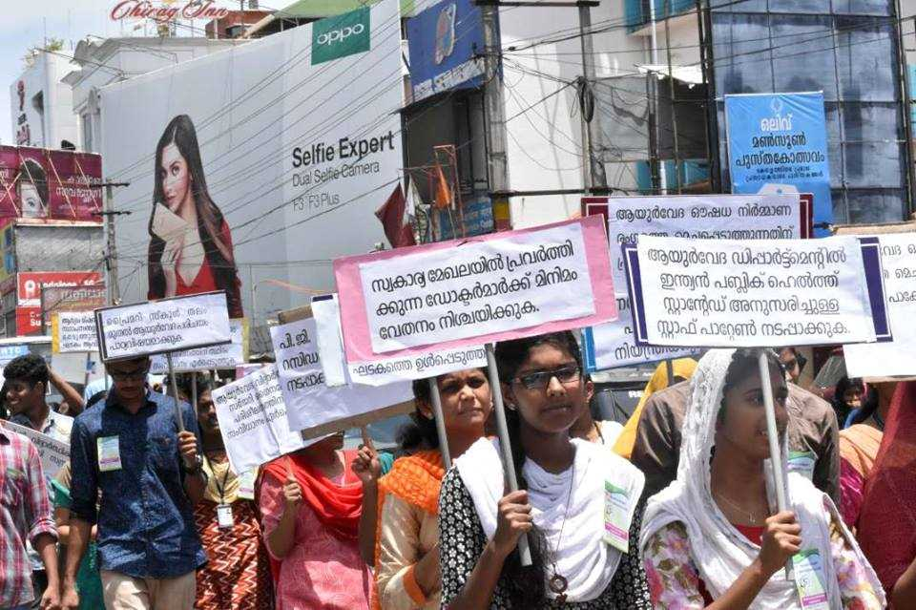
AMAI interventions
Education sector
Struggle for right to study surgery 1987.
Protest against Allopathy strike to stop BAMS students surgery training 1988.

Slide 37
AMAI interventions
Education sector
The 1st BAMS syllabus workshop conducted at Alwaye in 1990, joint board of studies formed .
Movements against MPSc course by Sanskrit University
Supported Kannur AVC students strike to get new campus 1990-95.

Slide 38
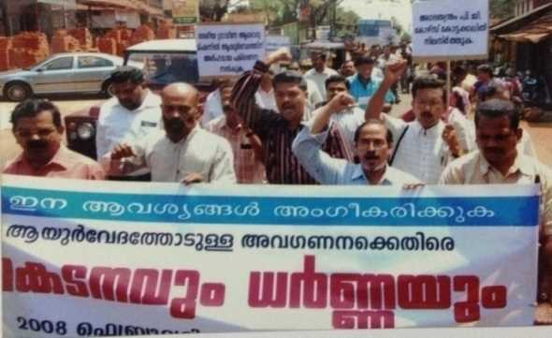
AMAI interventions
Education sector
Panchakarma Department at Tvpm AVC 2008.
House surgeons surgery training issue 2008 ( Modern medicine registration)
Reinstating PG seats in KB& R&B 2014

Slide 39
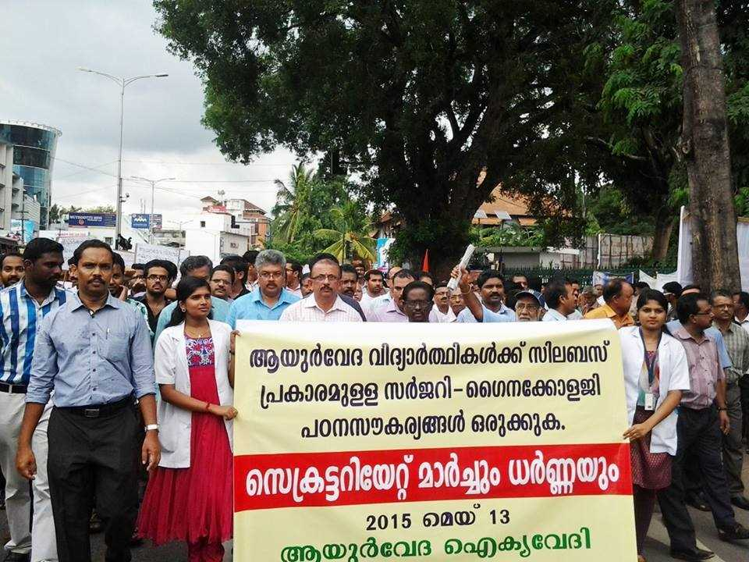
AMAI interventions
Education sector
Rural posting to self financing colleges.
Movements against MSR 2013
Surgery Gynecology posting issue 2015
Victory against IMA on surgery issue

Slide 40
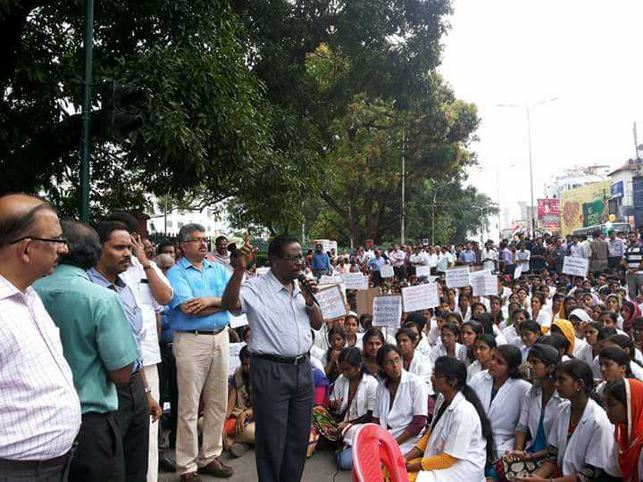
AMAI interventions
Education sector
Santhigiri issue 2014
Ahalya issue 2016
M.O Posts in Ayurveda Colleges
PG Diploma courses.

Slide 41
അംഗങ്ങളുടെ ക്ഷേമ പ്രവർത്തനങ്ങൾ
Health policy 2003 (Dr.Anilkumar & Dr.Dilip)
ASWAS 2005 (Dr.Mohan Syriac& Dr.Rammoham
Aswas Plus 2017 (Dr.G.Vinod Kumar &Dr.Rejith Anand)
AMAI Santhwanam 2018 (Dr.Raju Thomas & Dr.Sadath Dinakar)
Treatment support
Legal support

Slide 42
അംഗങ്ങളുടെ ക്ഷേമ പ്രവർത്തനങ്ങൾ
നിയമ സംരക്ഷണം
വള്ളിക്കാവ് കേസിൽ ഡോ.മനോജിനെ വെറുതെ വിട്ടത്
എക്‌സൈസ് അതിക്രമങ്ങൾക്കെതിരെ

Slide 43
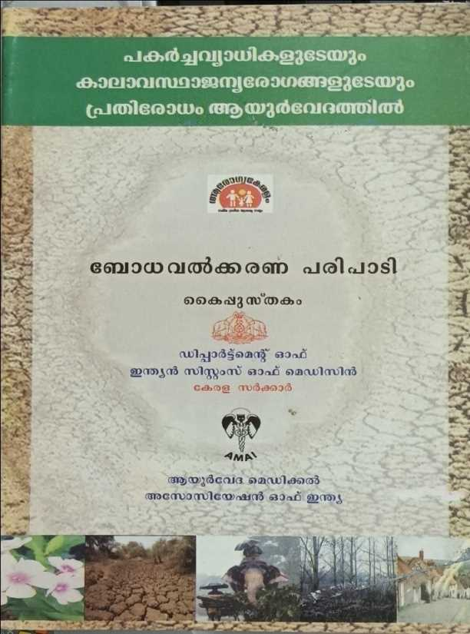
പൊതുജനാരോഗ്യ രംഗം
Communicable disease campaign in 2008 March 26. (Dr. V.G.Udayakumar/ Dr.Joji Thachil)
Hand book/ Guide line ,,
Protocol development – AMAanamRF
Emergency medicine kit – AMARF
Ayur Santhwanam
Koode, Thirike etc:

Slide 44

ആയുർവേദ പ്രചാരണം
Awareness programmes against Anti Ayurveda propagation 2014 onwards.
Observing health related days
Ayur Help
Arogya padtam
Fb page
Club House

Slide 45
AMAI interventions
Service sector
Reducing work load to MO’s in ISM through Advisory board 2008 (Dr. V.G.Udayakumar/Dr.Joji Thachil)
Medicine dispensing according to necessity (,,)
P.G. deputation to Medical officers 2008 (,,)
NRHM postings 2008 and latter salary enhancement. (,,)
Ayush Department 2015 (Dr.G.Vinod Kumar &Dr.Rejith Anand)

Slide 46
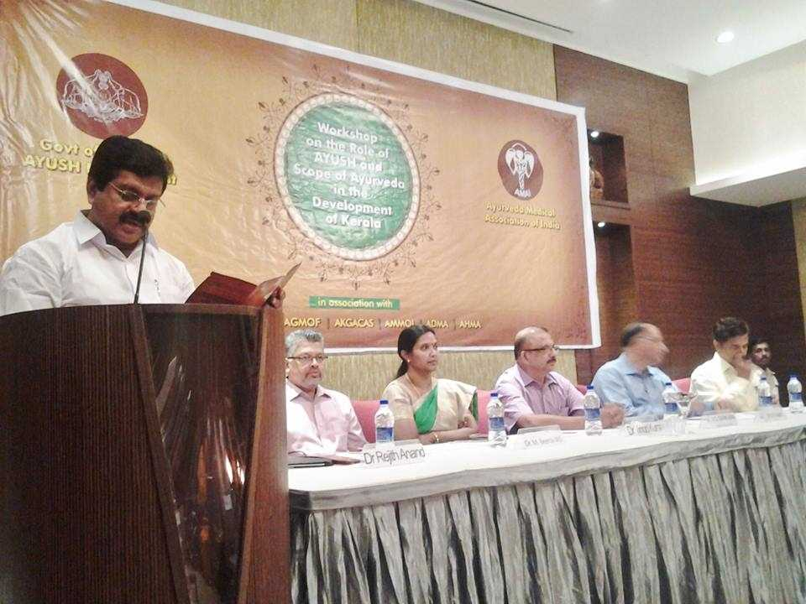
Policy interventions
Protest against unscientific Heath policy 2012 June 30
Vision conclave
Ayush Policy workshop
Kerala Health Policy
  Ayurveda Primary Health Centre (GAD’s)

Slide 47
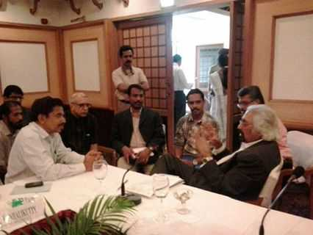
Policy interventions
Kerala Drug policy
Clinical establishment Act
NCISM Bill
  Separate entrance for PG
  State representation on Advisory council
Kerala Medical Practitioners Bill 2021

Slide 48
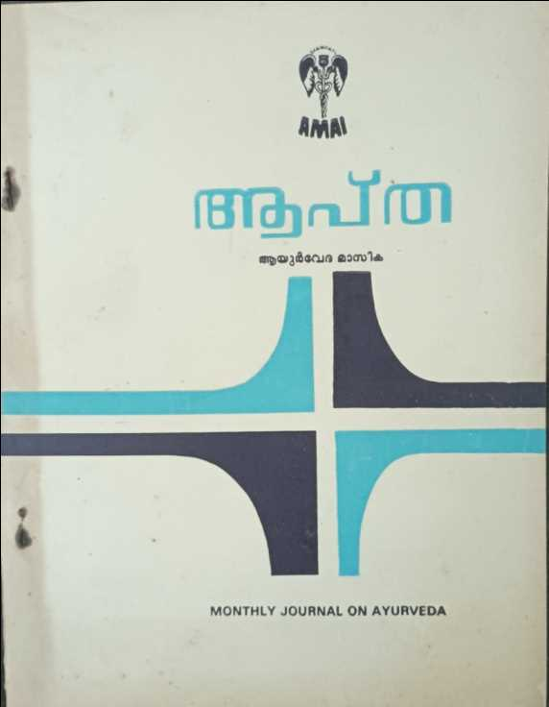
AMAI
Milestones & Achievements
Started APTA ,monthly journal of AMAI in 1988. ( Dr.J.Seetha Raman& Dr.M.K.Baby)
Declared CME’s as a regular programme after APTA seminar Kottakkal in 1990.

Slide 49
AMAI
Milestones & Achievements
Registered under ICSR act in 1996 at Malappuram (Dr. Anilkumar Dr.V.G.Udayakumar)
After 1997 organization moved in tune with bye law under the leadership of (Dr. Anilkumar & Dr.S.Dilipkumar)
  District committees strengthened and Area committees formed.
  Conferences were conducted according to bye law.
  Members directory 2000.

Slide 50
AMAI
Milestones & Achievements
CCIM representation by Dr.Anilkumar - 2004
ASWAS 2005 – Dr.Ram moham/ Mohan Cyriac
State Head Quarters 2007 (Dr.Ram moham/ Mohan Cyriac)

Slide 51
AMAI
Milestones & Achievements
TCMC representation 2008 (Dr. V.G.Udayakumar/Dr.Joji Thachil)
Seminar on Globalization 2008 (,,)
Advisory board representation 2009 (,,)
Board of Studies representation Calicut University-2009

Slide 52
AMAI
Milestones & Achievements
Women's committee 2009 (Dr. V.G.Udayakumar/Dr.Joji Thachil)
AMAI recognized for conducting CME’s
Excise expert committee membership 2009 ,,
National Expo 2010 Thrissur. ,,

Slide 53
AMAI
Milestones & Achievements
CCIM election victory 2011
CCIM Executive representation 2013
Panning Board working group representation 2016
Started TREATIS exclusively for scientific articles in 2014 (Dr.G.Vinod Kumar &Dr.Rejith Anand)

Slide 54
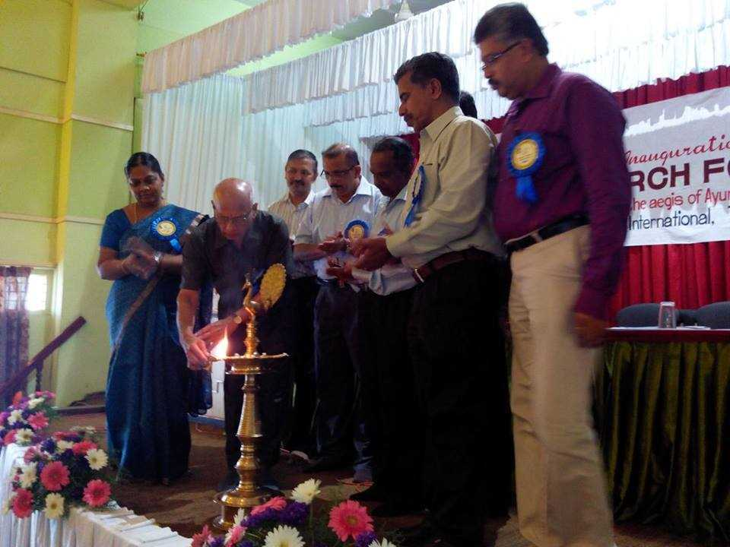
AMAI
Milestones & Achievements
Started LAISON OFFICE at Tvpm 2014. (Dr.G.Vinod Kumar &Dr.Rejith Anand)
Started AMAI Research Foundation 2014 Nov 23 (Dr.G.Vinod Kumar &Dr.Rejith Anand)

Slide 55
AMAI
Milestones & Achievements
KUHS Senate (Dr.G.Vinod Kumar &Dr.Rejith Anand)
2nd CCIM victory 2018(Dr.Rajuthomas&Dr.Sadath)
Kerala Medical Council (Dr.Rajuthomas&Dr.Sadath)
Medicinal Plant Board (Dr.Rajuthomas&Dr.Sadath)
Clinical Establishment Council (Dr.Rajuthomas&Dr.Sadath)
District Committee Offices 2018 ,2020

Slide 56
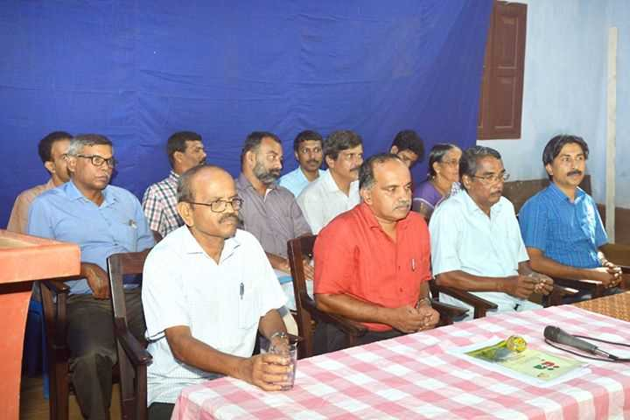
Co Operative sector
Thiruvananthapuram
Kollam- Bheshajam
AMPIC Pharmacy Thrissur
Kozhikkode – Kerala Ayurveda Co Op Society

Slide 57
Organizational crisis
After 1995 CCIM election
  TCR DC Dissolved and Ad hoc committee appointed
2010 After 13th State Conference
  In the name of private practitioners
  Majority of them returned to AMAI
  No representation in any of the above issues

Slide 58

Make a history or be a part of it

